Slide 1
Indoor Air Quality Monitoring Application
Group 16 – NT118.012.MMCL
Lecture: Phd. Thái Huy Tân

Slide 2


Members
Lê Huỳnh Quang Vũ
Đinh Tiến Đạt
21522797
19521331

Slide 3
TABLE OF CONTENT
01
Overview
UX/UI
02
03
Function
Demo
04
Project information
Application layouts
Application functions
Realeased product

Slide 4
01
Overview

Slide 5

Introduction
Name: ClouD.
Platform: Android.
Decription: A simple app for monitoring indoor air quality.

Slide 6




Specifications
Java 8
Gradle 8.0
SDK 33 (API 33)
Android Studio 2023.1.1

Slide 7
02
UX/UI

Slide 8
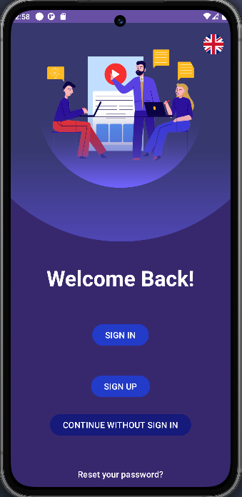
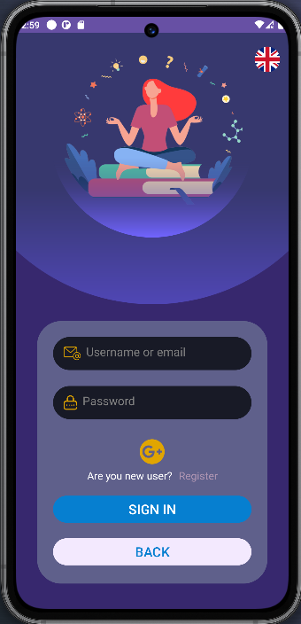
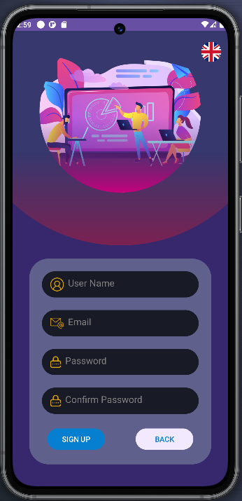
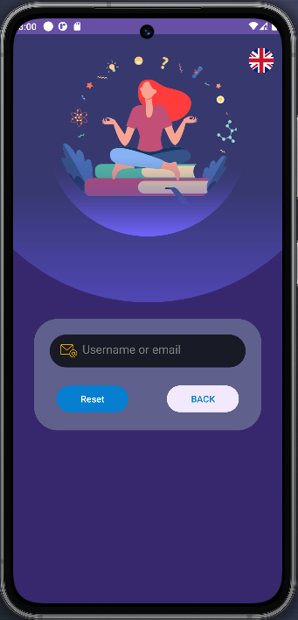
Application layouts

Slide 9
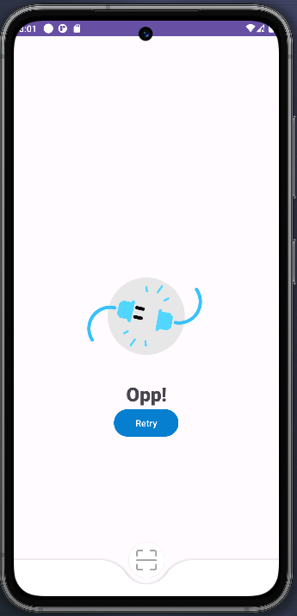
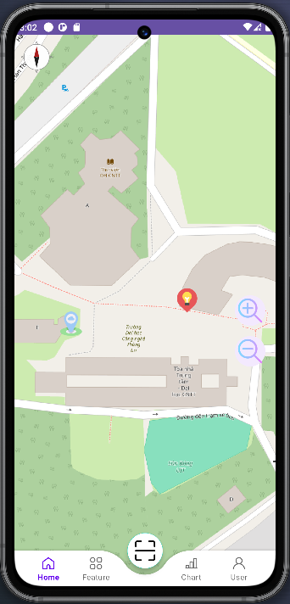
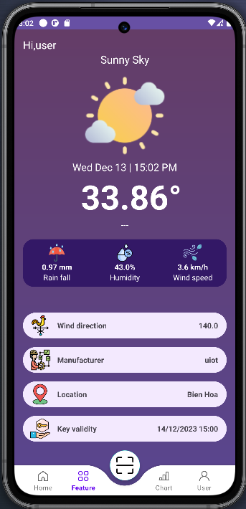
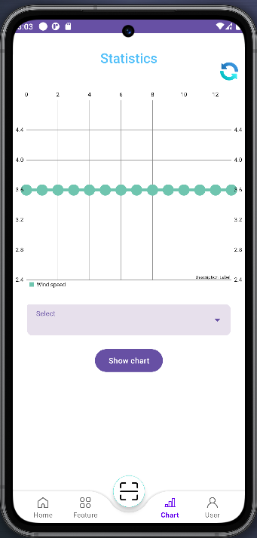
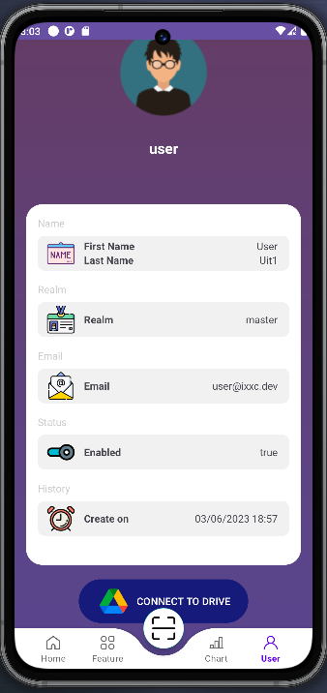
Application layouts

Slide 10
Function
03

Slide 11
1
Change languages.
Sign in.
Sign up.
Save user.
Reset passwords.
API: token, device, asset.
2
3
4
5

Slide 12
Sign in.
Sign up.
1
2
API: sign up, sign in.

Slide 13
Retry (recall API).
Navigation bar.
1
2

Slide 14
1
Refresh graph.
Choose data source.
Show graph.
2
3

Slide 15
Show cloud database.
1

Slide 16
Demo
04

Slide 17
Demo

